Slide 1

TOPIC :-
Guided By :- Submitted By:-
Mrs. Vaishali ASHUTOSH CHOUHAN (0823CS201018)

Slide 2
Contents
Abstract
Introduction
Problem Domain
Solution Domain
Snap Shots
Technology and Tools
System Domain
Application Domain
Conclusion
Future Enhancements
References

Slide 3

Abstract
Easy to use
User can easily find paying gest room at low cost in city’s like
Delhi, Mumbai, Bengaluru and Hyderabad.
Easily compare different PG.
Filter and shorting feature make easy to find your best room.
After login you got your dashboard page where you easily manage
your choice or profile.

Slide 4

Introduction
The project, Paying Guest Rental Management System is a web-based application that allows the admin to handle all available room activities online. Interactive GUI and the ability to manage various PG bookings and rooms make this system very flexible and convenient. The owners are very busy people and does not have the time to sit and manage the entire activities manually on paper. This application gives them the power and flexibility to manage the entire system from a single online system. Paying Guest management system project provides room booking, and other necessary paying guest management features. The system allows the owner to post available rooms in the system. Students can view and book PGs online.

Slide 5
Problem Domain
Finding PG in city's like Delhi, Mumbai, Bengaluru, Hyderabad.
Short listing your favorite PG.
Want to read comment of visitors.
Manage or edit profile.
Mark our interested Paying Gest Rooms.

Slide 6

Solution Domain
Very easy to find or visit PG rooms.
Shorting and Filter available.
Read or write comment feature is available.
Dashboard page available to easily manage your profile.
Mark your interested room on property_detail page.

Slide 7
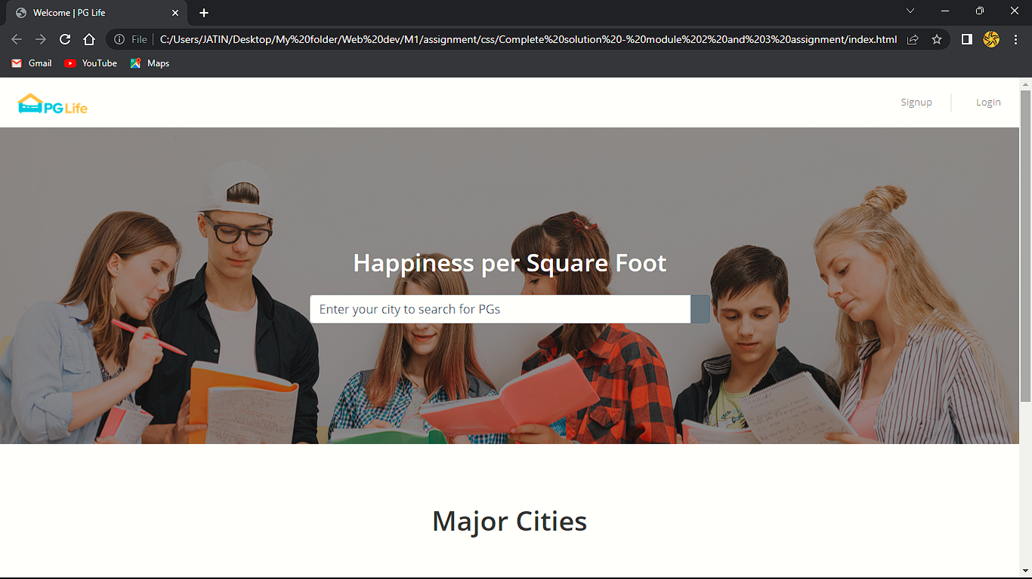
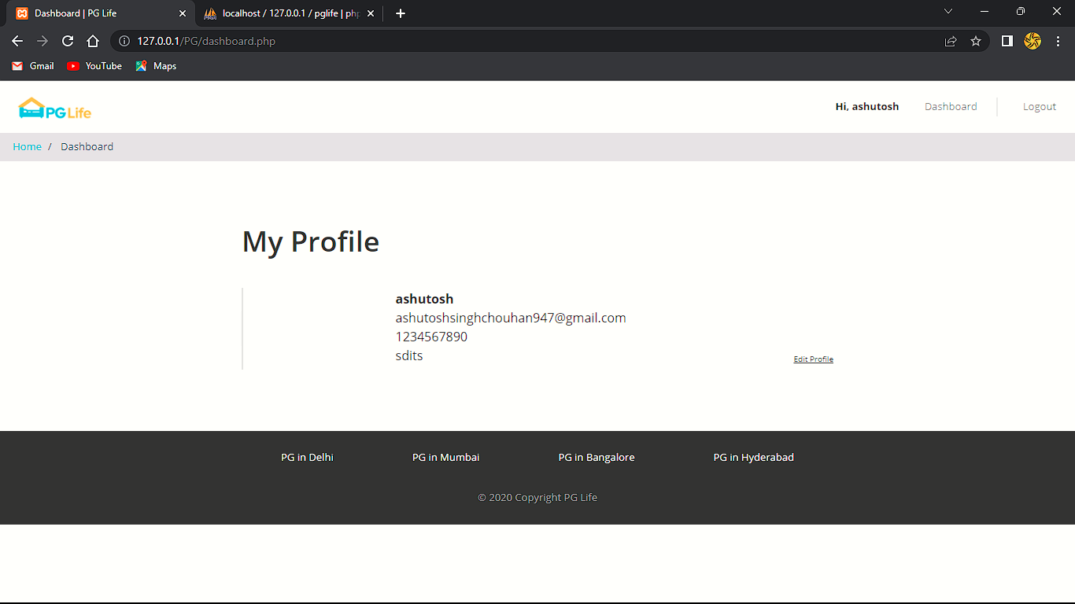
Snapshot
Home page Dashboard page

Slide 8
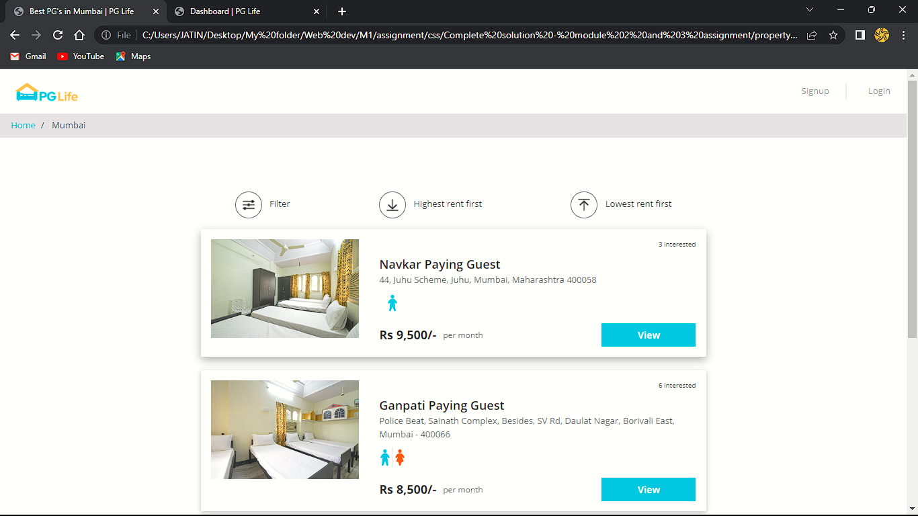
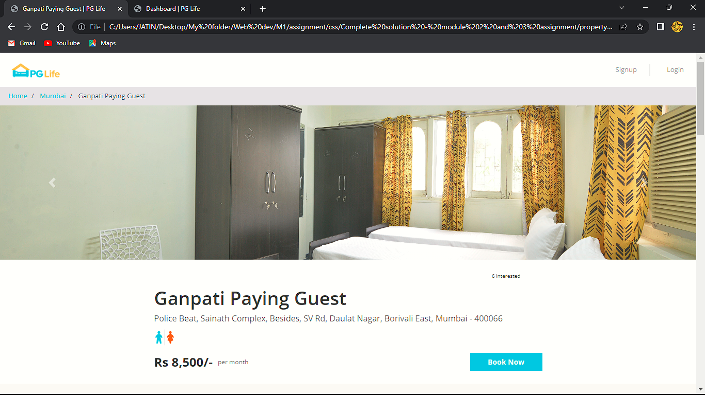
Property_details page
Property list page

Slide 9
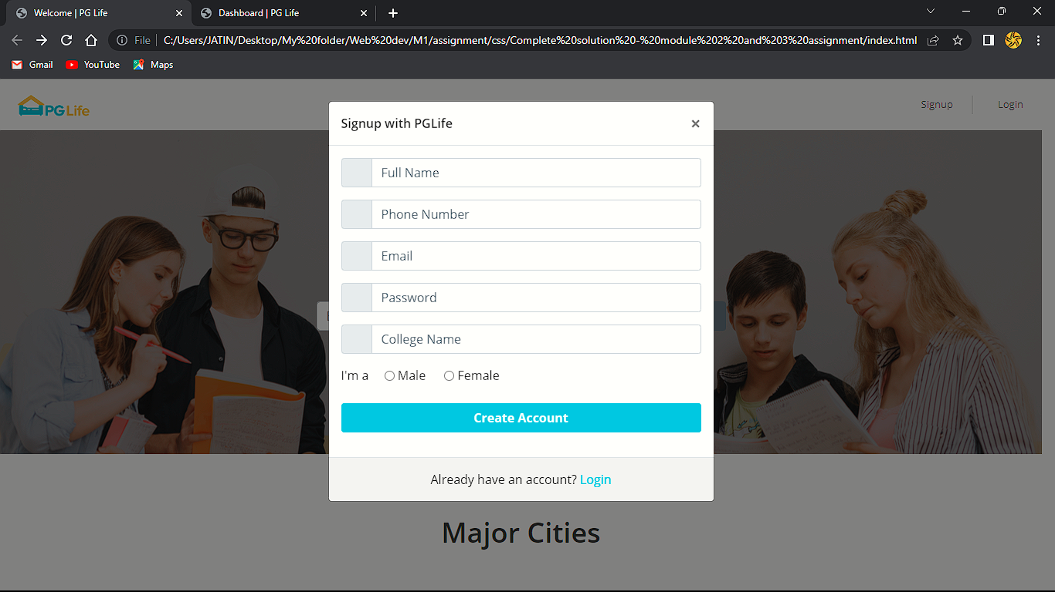
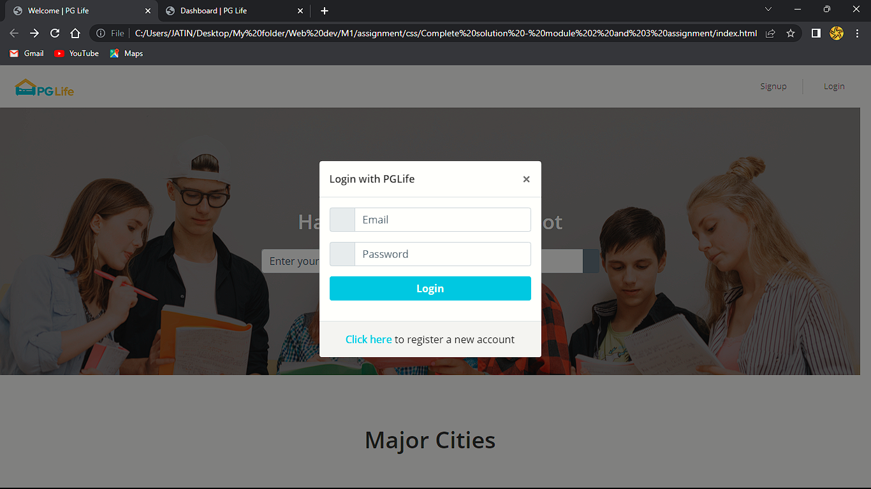
Signup page
Login page

Slide 10
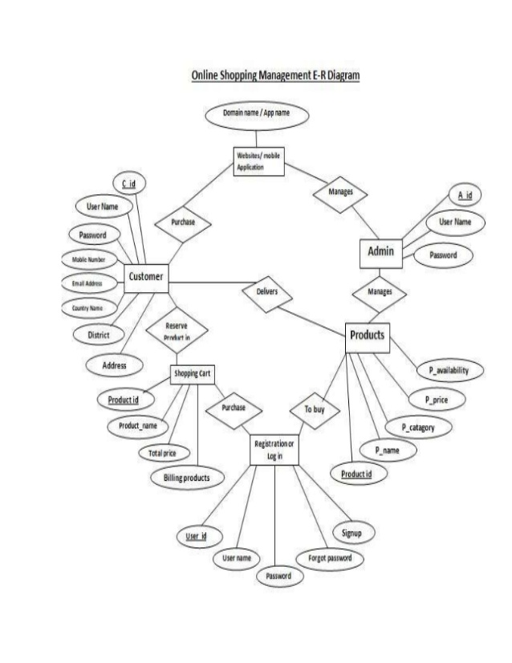
Technology and tools
UseCase diagram for Online Car Accessories
ER Diagram

Slide 11
Data flow diagram

Slide 12
System Domain
3.1. Software Requirement:-
Operating System:- Windows family.
Front End:- HTML5, CSS3, JavaScript, Bootstrap.
Back End:-PHP.
Database:- MySQL.
Server:- Apache Server.
UML Design:- StarUML.
3.2. Hardware Requirement:-
Processor:- Dual core and above.
Hard disk:- 50 GB or above.
Ram:- 512 MB or above.

Slide 13
Conclusion
Easily find PG room in major city's.
Shorted list best value rooms.
Book your room online.
Responsive website easily run on each devices
Signup and login process is very simple

Slide 14
References
Google
Bootstrap
Images
Localhost and Database

